Slide 1
SAMHSA Updates
Mirna Herrera, MA MT-BC, CPS
Regional Behavioral Health Advisor
Substance Abuse and Mental Health Services Administration
U.S. Department of Health and Human Services
03/04/2024
Notes:
Presentation title slide
Do not change colors
Add title where designated

Slide 2
SAMHSA regional offices

Slide 3
Mission and Vision
MISSION
SAMHSA’s mission is to lead public health and service delivery efforts that promote mental health, prevent substance misuse, and provide treatments and supports to foster recovery while ensuring equitable access and better outcomes.
VISION
SAMHSA envisions that people with, affected by, or at risk for mental health and substance use conditions receive care, thrive, and achieve wellbeing.
Notes:
The SAMHSA Strategic Plan will provide a roadmap to carry out the vision and mission of SAMHSA over the next four years. We posted an Interim Strategic Plan in November 2022 which highlights our new mission, vision, priorities and guiding principles. The full plan is still under development and wasposted on out website for public comment on April 11, 2023 – comment period closes April 27th..
As an agency, we are especially aware that addressing some of our nation’s toughest challenges requires a dedicated, diverse, and highly skilled staff, talented and engaged leadership, and a culture that fosters innovation, collaboration, and data-driven solutions.

Slide 4
SAMHSA’s Overarching Priorities and Guiding Principles
2. Enhancing Access to Suicide Prevention & Mental Health Services
Equity
1. Preventing Substance Use and Overdose
3. Promoting Resilience and Emotional Health for Children, Youth, and Families
Trauma-Informed Approaches
SAMHSA’s Priorities
Commitment to Data and Evidence
5. Strengthening the Behavioral Health Workforce
4. Integrating Behavioral and Physical Health Care
Recovery

Slide 5
SAMHSA’s most recent highlights
SAMHSA’s Office of Recovery celebrated 1 year
988 Celebrate 1 year and expanding services to subgroups
Videophone (ASL for deaf and hard of hearing)
Spanish
Veterans
LGBTQIA+
Peer Support Certification Guidelines
TIP 65: Counseling Approaches To Promote Recovery From Problematic Substance Use and Related Issues
Harm Reduction Framework (2024)
Overdose Response and Prevention toolkit (2024)
Consumer Guide: How Can a Peer Specialist Support My Recovery From Problematic Substance Use? For People Seeking Recovery (2024)

Slide 8
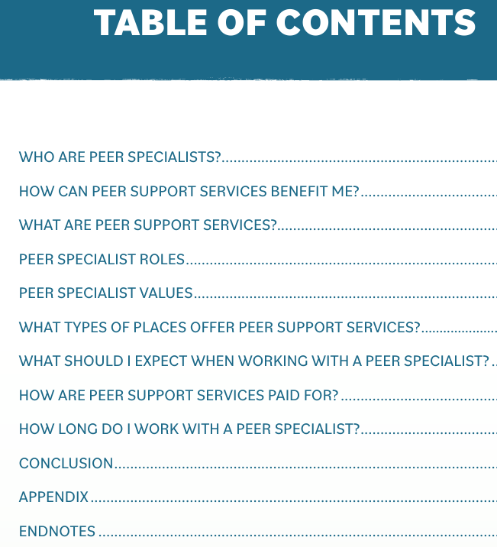
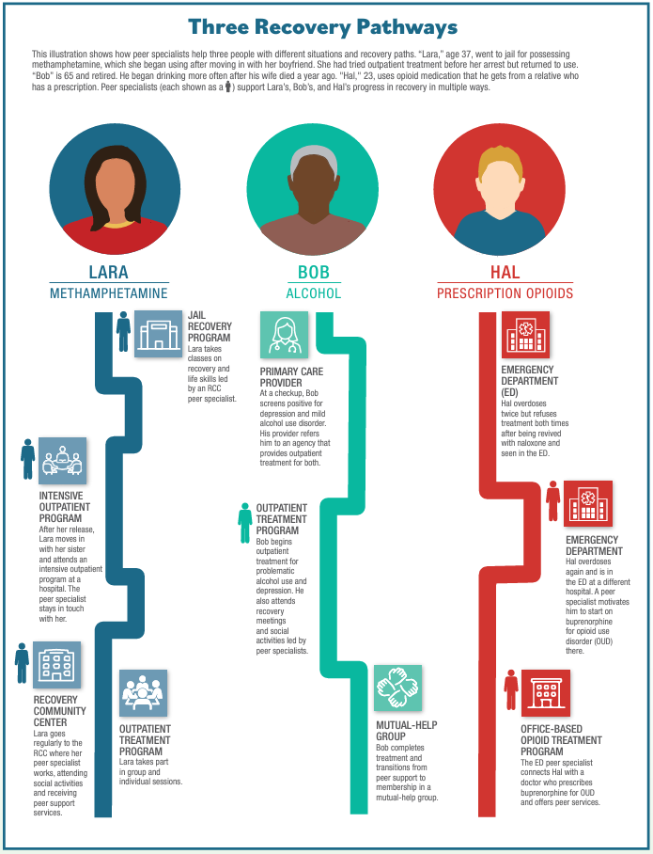

Slide 9
2022 National Survey on Drug Use and Health- Recovery Data Highlights
Only 1 in 5 people with opioid addiction get the medications to treat it, study finds
1 in 10 Americans report having resolved a significant substance use problem
3 out of 4 people who experience addiction eventually recover
1 in 4 adults aged 18 or older perceived that they ever had a mental health issue. Among these adults, 65.8% considered themselves to be in recovery or to have recovered.

Slide 10
Current Recovery Focused NOFOs
Building Communities of Recovery: Closes April 29th
Statewide Consumer Network Program: Closes April 8th
Statewide Family Network Program: Closes April 8th
Grants to Expand Substance Use Disorder Treatment Capacity in Adult and Family Treatment Drug Courts: Closes April 1st
For more information on each grant:
https://www.samhsa.gov/grants/grants-dashboard

Slide 11
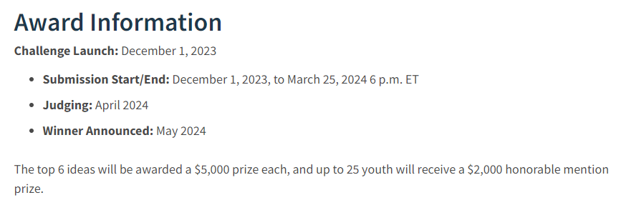

Slide 12
SAMHSA’s 2023-2026 Data Strategy : Minimizing Burden, Maximizing Utility
Substance Abuse and Mental Health Services Administration
U.S. Department of Health and Human Services
Notes:
https://www.samhsa.gov/about-us/data-strategy

Slide 13
Timeline Overview
April 2022: Proposed data strategy (“DS”)
May 2022: Convened cross-SAMHSA Data Strategy Workgroup (DSW)
Co-led by OAS, CBHSQ, and CSAT staff
Comprised of bi-weekly meetings with designated staff from across SAMHSA
August 2022: Began listening session series (n=23) with grantees, national bodies, racial/ethnic organizations, measurement experts, researchers, tribal representatives, and federal agencies
October 2022: Completed DS 0utline first draft, integrated DSW feedback
November 2022: Finalized outline
January 2023: Completed DS draft
Spring 2023: Solidified roles/responsibilities within the DS
August 2023: Cross-SAMHSA comment period (received >150 comments)
November(ish) 2023: Publish Data Strategy

Slide 14
Core Principles
Focus data efforts across the lifespan, with special attention paid to children and youth and older adults.
Incorporate measures that are recovery-centric, trauma-informed, and culturally and linguistically appropriate.
Prioritize evidence-based and validated measures whenever possible.
Minimize data burden for SAMHSA grantees and those they serve.
Promote collaboration between and across Centers and Offices so that expertise and knowledge are fully leveraged.
Align the DS with the Foundations for Evidence Based Policymaking Act.

Slide 15
Goals
Goal 1—Enhance SAMHSA’s ability to capture and maintain high-quality data
Goal 2—Conduct robust performance monitoring, evaluation, and surveillance
Goal 3—Strengthen access to, utilization of, and dissemination of SAMHSA’s data
Goal 4—Expand and strengthen SAMHSA’s data workforce capacity

Slide 16
Goal 1: Enhance SAMHSA’s Ability To Capture And Maintain High-quality Data
Objective 1: Collect and/or leverage data on recovery, social determinants of health (SDOH), race and ethnicity, and sexual orientation and gender identity (SOGI)
Strategy 1: Integrate recovery and SDOH measures
Strategy 2: Standardize collection of demographic information regarding race and ethnicity and SOGI information
Objective 2: Streamline performance data collection tools
Strategy 1: Implement a low-burden performance data collection strategy that ensures both compliance and high-quality performance data on SAMHSA’s grants
Strategy 2: Establish a SAMHSA-led collaborative process to support ongoing development/updates of tools
Strategy 3: Create resource materials that improve understanding and high-quality collection of performance measures

Slide 17
Goal 2: Conduct Robust Performance Monitoring, Evaluation, And Surveillance
Objective 1: Modernize data storage and data systems
Strategy 1: Procure integrated and interoperable data platforms
Strategy 2: Leverage secondary data sources that collect real-time metrics
Strategy 3: Invest in data literacy/capacity for SAMHSA-funded entities
Objective 2: Assess the impact of SAMHSA’s funds on outcomes using existing block grant and client services data
Strategy 1: Create mechanisms for regular cross-SAMHSA review and analysis of grantee data
Objective 3: Promote performance evaluation at the grantee and state levels
Strategy 1: Promote continuous quality improvement among grantees and states
Strategy 2: Strengthen local performance monitoring and evaluation

Slide 18
Goal 3: Strengthen Access To, Utilization Of, And Dissemination Of SAMHSA’s Data
Objective 1: Enhance utility of SAMHSA’s data files
Strategy 1: Assess value of SAMHSA’s data
Strategy 2: Establish internal and/or external data dashboards
Strategy 3: Support access to data by subset
Objective 2: Enhance utility of SAMHSA’s data deliverables
Strategy 1: Assess value of SAMHSA’s data products
Strategy 2: Establish a data communications strategy with focus on improving/advertising/promoting SAMHSA data products and ensuring broad usability

Slide 19
Goal 4: Expand and Strengthen SAMHSA’s Data Workforce Capacity
Objective 1: Realign human capital to promote timely and actionable data collection, analysis, and dissemination
Strategy 1: Create focused and responsive performance monitoring and evaluation through investments in human capital
Objective 2: Enhance in-house capacity as it relates to data collection and analysis
Strategy 1: Hire staff who possess education and experience in the following core areas: data visualization, data linkage, data science, and mixed methods research
Strategy 2: Enhance SAMHSA-wide staff data literacy

Slide 20
Thank You
SAMHSA’s mission is to lead public health and service delivery efforts that promote mental health, prevent substance misuse, and provide treatments and supports to foster recovery while ensuring equitable access and better outcomes.
Mirna Herrera
Mirna.Herrera@SAMHSA.hhs.gov
202-878-1313
www.samhsa.gov
1-877-SAMHSA-7 (1-877-726-4727) ● 1-800-487-4889 (TDD)

