Slide 1
Collaboration in Mental Health and Substance Use Disorder Treatment
A Unified Approach to Healing and Support
Suneal Menzies, COO
Assisted Recovery Centers of America

Slide 2
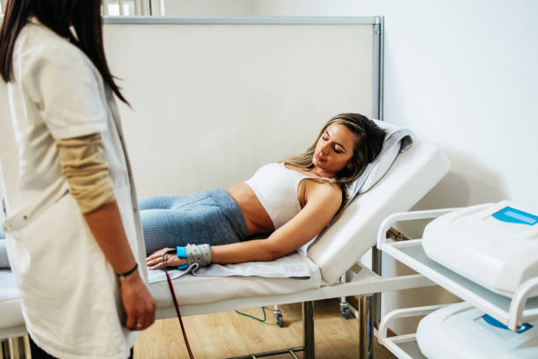
Treatment and Recovery
In the field of Substance Use Disorder (SUD), the terms "treatment" and "recovery" refer to different stages in the process of addressing and managing the disorder
Treatment involves the initial phase of addressing the substance use disorder. It usually includes interventions such as detoxification, counseling, medication-assisted therapy, and support groups. The goal of treatment is to help individuals stop using substances and to manage the medical and psychological issues related to their substance use. Treatment can be provided in various settings, including inpatient, outpatient, and residential facilities, and is often guided by healthcare professionals specializing in addiction medicine.

Slide 3
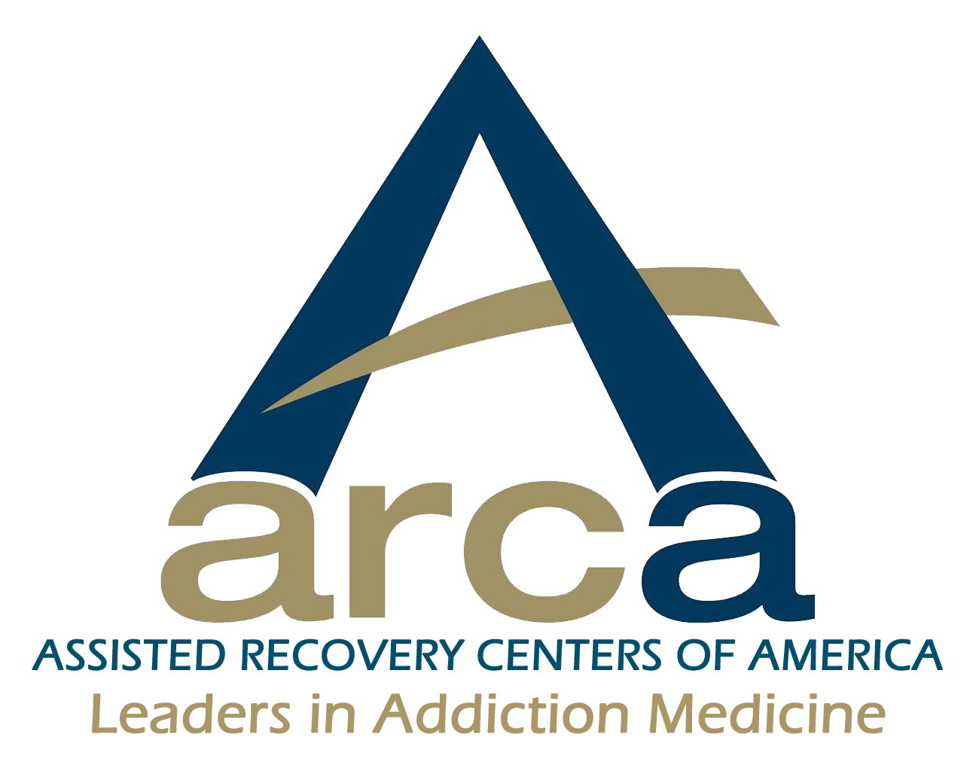
Treatment and Recovery
Recovery, on the other hand, refers to the lifelong process of maintaining abstinence from substance use while improving one's health, wellness, and quality of life. Recovery goes beyond the cessation of substance use and includes personal growth, rebuilding relationships, and integrating into society as a contributing member. Recovery is a personal and dynamic journey that involves developing new coping strategies, creating a supportive social network, and often participating in community or peer support groups like 12-step programs.
Treatment is a more acute phase focusing on cessation of substance use and addressing immediate health concerns, whereas recovery is a long-term, ongoing process that encompasses holistic well-being and personal development beyond just substance use.

Slide 4
Collaboration and Overlap
Recovery support and treatment providers should collaborate effectively:
Complementary Roles: Treatment providers refer clients to RSS providers to continue their recovery journey in a supportive environment. Recovery support service providers refer clients to treatment providers to continue their recovery journey in the context of a comprehensive model of care
Continuity of Care: After completing a formal treatment program, recover support providers maintain and improve upon the work and progress made during treatment
Shared Goals: Collaboration ensures a holistic approach to recovery, addressing unique needs of each individual’s physical, mental, and social health
Community-Based Support: Recovery support providers often help individuals connect with community resources, support groups, and activities that reinforce their recovery journey
Holistic Approach: By working together, these providers address not just the primary diagnosis itself, but also underlying issues such as substance use or mental health disorders, trauma, and social challenges that contribute to substance use

Slide 5
Call to Action
When an individual with a Mental Health and or Substance Use Disorder has access to recovery support services, they are more likely to develop healthy social, personal, and family functioning. This support paired with treatment providers, provides an individuals best opportunity for long-term, stable, recovery.
Treatment providers and recovery support providers can and must strengthen the network of providers to better serve individuals with Mental Health and or Substance Use Disorders.
Referrals for additional and complimentary services
Communication between agencies
Sharing resources, information and best practices

Slide 6
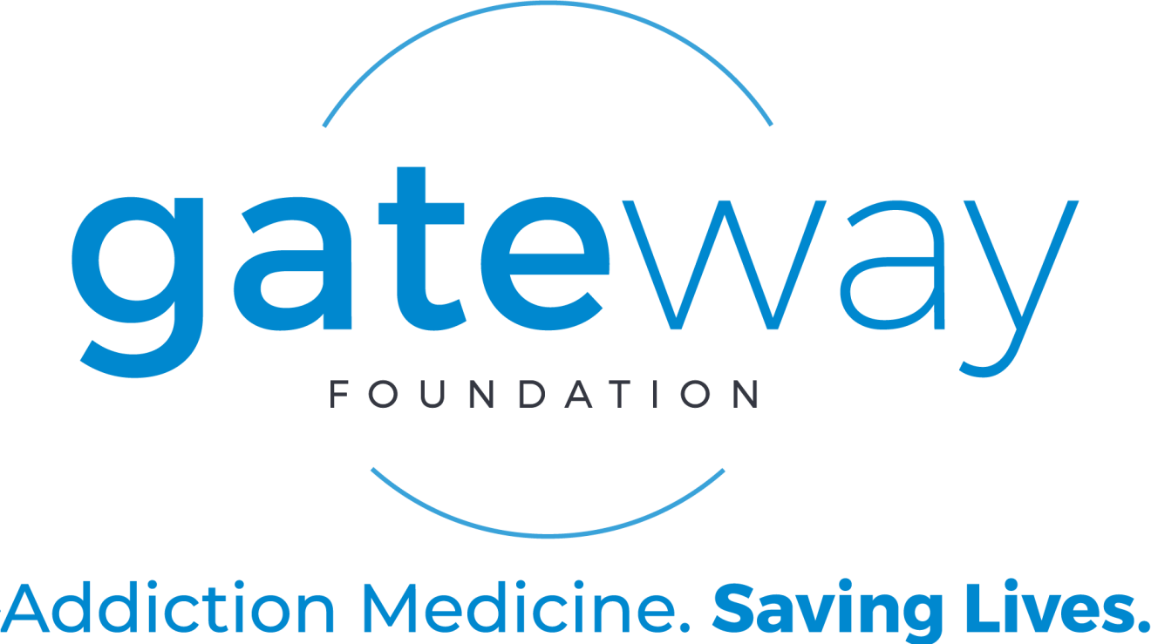
CSTAR Program Providers
There are currently 34 CSTAR providers in Missouri
13 providers operate in the Eastern Region
9 providers operate in the Southeastern Region
11 providers operate in the Southwestern Region
14 providers operate in the Western Region

Slide 7
ASAM Treatment Providers
Mental Health America: Housing is essential care for people with Mental Health and Substance Use Disorders
Homelessness and mental disorders are not the same, but for the 20-25% of those who are both unhoused and ill the problems are compounding, confusing, and complex. There are some solutions:
Housing First/Access to safe and reliable housing
Mobile Outreach
Wrap-Around Services
Compassionate Communities with integrated care models
MO treatment providers offer evidence-based mental health and substance use disorder treatment
Follow standard of care/guidelines to assess, diagnose, and provide comprehensive care to individuals with mental health and or substance use disorders which is done via a standardized means of assessing.

Slide 8
ASAM Levels of Care
Effective July 1, 2022, CSTAR services were approved by the Centers for Medicare and Medicaid Services (CMS) to be provided in accordance with the American Society of Addiction Medicine (ASAM) Criteria. The following ASAM levels of care are covered under the MO HealthNet program. Service definitions, staffing, assessment, treatment planning, and other requirements for each level of care are included in this manual.
Level of Care | Description
Level 0.5 | Early intervention
Level 1 | Outpatient services
Level 1 | Opioid treatment services (OTP)
Level 1-WM | Ambulatory withdrawal management without extended on-site monitoring
Level 2.1 | Intensive outpatient services
Level 2-WM | Ambulatory withdrawal management without extended on-site monitoring
Level 2-WM-EM | Ambulatory withdrawal management with extended on-site monitoring
Level 2.5 | Partial hospitalization services
Level 3.1 | Clinically managed low intensity residential services
Level 3.2-WM | Clinically managed residential withdrawal management
Level 3.3 | Clinically managed population specific high intensity residential services
Level 3.5 | Clinically managed high intensity residential services
Level 3.5 | Clinically managed high intensity residential services (women and children)
Level 3.7 | Medically monitored intensive inpatient services
Level 3.7-WM | Medically monitored inpatient withdrawal management

Slide 9
The Six Dimensions of the ASAM Criteria
1.
2.
3.
4.
5.
6.
Acute Intoxication and/or Withdrawal Potential
Biomedical Conditions and Complications
Emotional, Behavioral or Cognitive Conditions and Complications
Readiness to Change
Relapse, Continued Use or Continued Problem Potential
Recovery and Living Environment

Slide 10
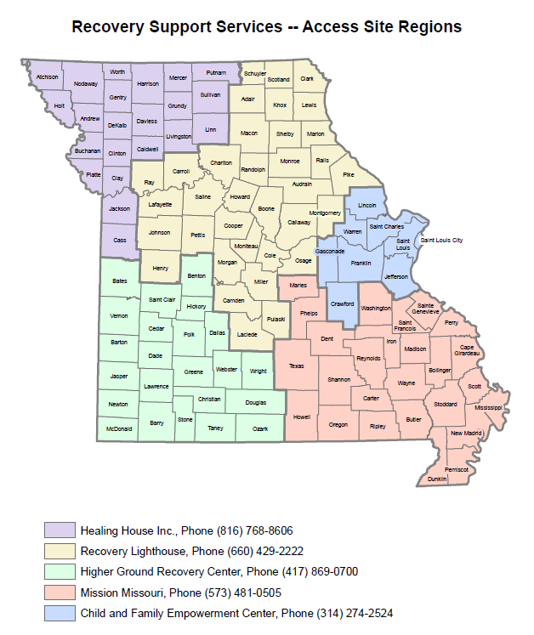
Missouri Coalition of Recovery Support Providers (MCRSP)
A member organization of National Alliance for Recovery Residences (NARR) and Alliance for Recovery Centered Organizations (ARCO)
5 Access sites across 5 regions
Includes 60 member organizations which provide
Recovery Support Services serving 4,153 clients annually
8 Recovery Community Centers serving 25,900 clients annually
6 Peer Respite programs serving 667 in 6 months
1,500 active Certified Peer Specialists/Full Service Partners
2 Family Recovery Programs serving 304 families
206 NARR Accredited Residence Houses
2335 Beds – 1373 Men, 962 Women

Slide 11
RSS Outcomes in Missouri*
98% have no new arrests
90% are in stable housing
88% are abstinent from alcohol and drug use
94% have had no additional adverse consequences from drug and alcohol use
63% are employed
91% demonstrate greater pro-social connectivity
97% were satisfied with Recovery Support Services
*Government Performance and Results Act Federal Data

Slide 12
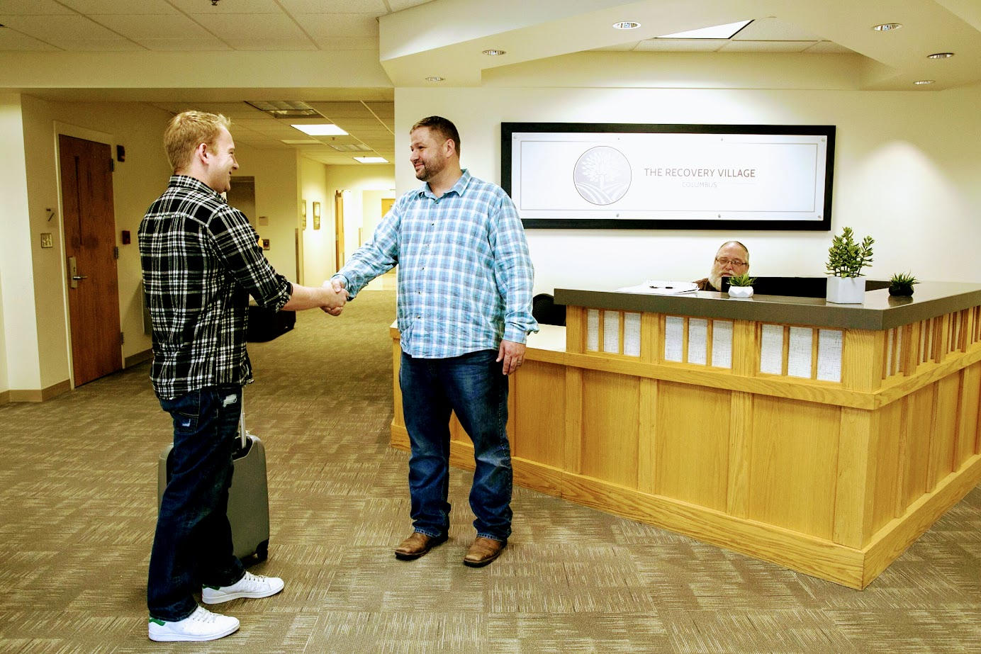
Access Sites Access Sites exist to advocate for clients and assist them with accessing resources and services to assist them in their recovery.
Central point for consumers to receive immediate access to treatment and recovery support services
Screening
Clinical assessment
Recovery plan development
Advocacy & coordination of resources and supports for consumers
Case Management
Voucher Management and Recovery Coordination
Consumers can use vouchers at any agency within the network of contracted RSS providers
Data collection & outcomes tracking
Intake interview (GPRA)
On-going recovery management check-ups (twice per month)
Outcomes tracking (follow-up GPRA Interview)
Recovery is the goal * Recovery is a process * Recovery requires all of us working together

Slide 13
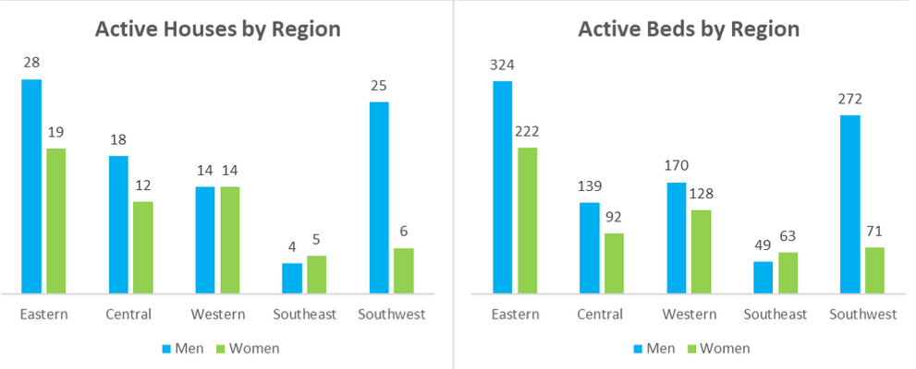
Recovery Support Providers
Recovery Support Services include all services which provide support for individuals with Mental Health and or Substance Use Disorders in the vulnerable early phase of recovery.
Care Coordination
Peer Services and Interaction
Individual and Group Counseling
Recovery Coaching and Counseling
Case management for housing, food, transportation, and employment assistance
15 Recovery Support Providers in Eastern region
47 sober living houses with a total of 546 beds
Recovery Support Services work! After six months clients report:
90% in stable housing
88% abstinent from drugs and alcohol
98% no new arrests

Slide 14
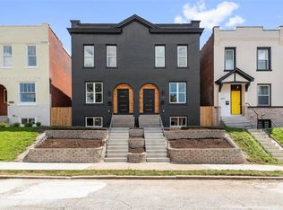
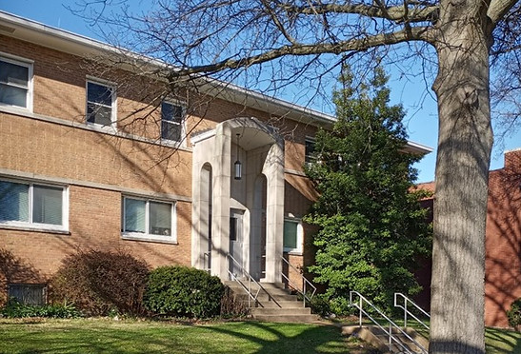
ARCA Recovery Housing
Respite housing for seven male residents and seven female residents in N. City St. Louis
Two female residences providing housing for up to 28 people
Thirteen male residences providing housing for up to 147 people
In total, ARCA provides housing for 189 residents at a time
Coming soon – 45 bed facility in SE MO in partnership with Gibson

Slide 15
Transitioning from Inpatient to Outpatient Treatment
Example:
A person completes an inpatient detox and rehab program (ASAM Level 3) where they receive intensive therapy and medical support for substance use disorder.
Client is assessed into level 2.5 during which time dimension 6 is evaluated (recovery housing and living environment)
Role of RSS Provider:
As the inpatient program comes to an end, the individual is not ready to return to their previous living environment, which may be filled with triggers and stressors.
CSTAR provider should work with RSS /Housing provider to see warm hand off. Recovery housing can serve as a transitional step where they continue their recovery journey – should be discussed and reviewed during assessment
RSS provider provides a smoother transition from the intensity of inpatient treatment to a less restrictive setting and the structure, accountability, support, and resources to commit to outpatient care plan

Slide 16
Sustaining Recovery in the Community
Example:
An individual has progressed through inpatient and team based outpatient treatment, achieved and maintained sobriety and is now focused on rebuilding their life in the community.
Role of RSS (Housing) Provider:
Recovery housing continues to be valuable at this stage by offering a sense of community and accountability. 90 days into their stay at the house a resident takes as weekend out to be with his or her family and friends.
During this time the resident experiences a slip up and relapse leaving them in an acute and compromised state when they return home to the recovery house. RSS/Housing staff should make referral to and work with resident and family to get individual to CSTAR provider and higher level of care.

Slide 17
Challenges and Opportunities
Treatment Agencies unaware of RSS providers and services offered
Clients hesitant to engage due to duplication of services
Financial and staffing challenges may seem to leave little time for partnership
There is a chance to create more and better partnerships
Allows agencies to refer for supplemental services without taking on the expense of additional programs
Recovery support services providers should integrate ASAM-recommended services into their program
This collaboration ensures a holistic approach to recovery, addressing both mental health and substance use needs – staffing and sharing of pertinent information

